Slide 1

Roles of Networks

Slide 2
Objectives
After completing this chapter, students will be able to:
▪ Explain how multiple networks are used in everyday life.
▪ Explain the topologies and devices used in a small- to medium-
sized business network.
▪ Explain the basic characteristics of a network that supports
communication in a small- to medium-sized business.
▪ Explain trends in networking that will affect the use of networks in
small to medium-sized businesses.

Slide 3
Role of Networks
Globally Connected
LANs, WANs, and the Internet
The Network as a Platform
The Changing Network Environment
Protocols
Examine networking principles and their protocols

Slide 4
Globally Connected

Slide 5
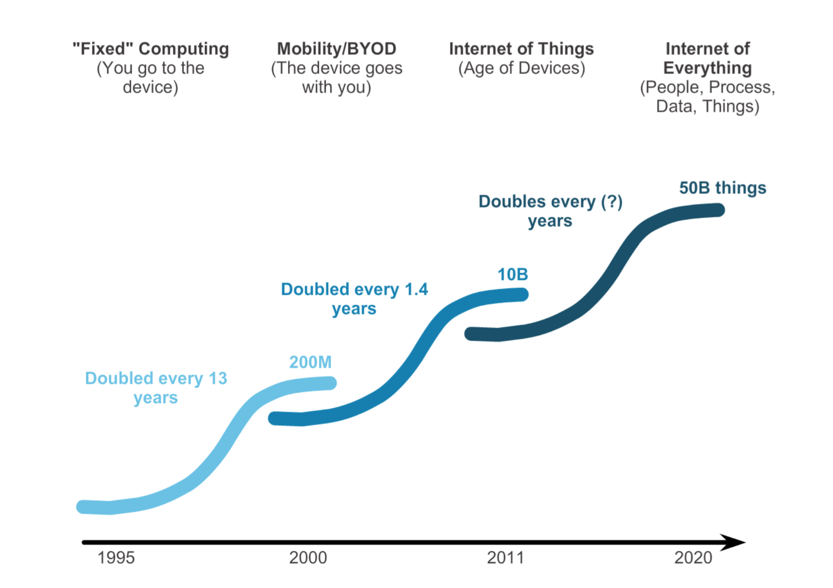
Networking Today Networks in Our Past and Daily Lives

Slide 6
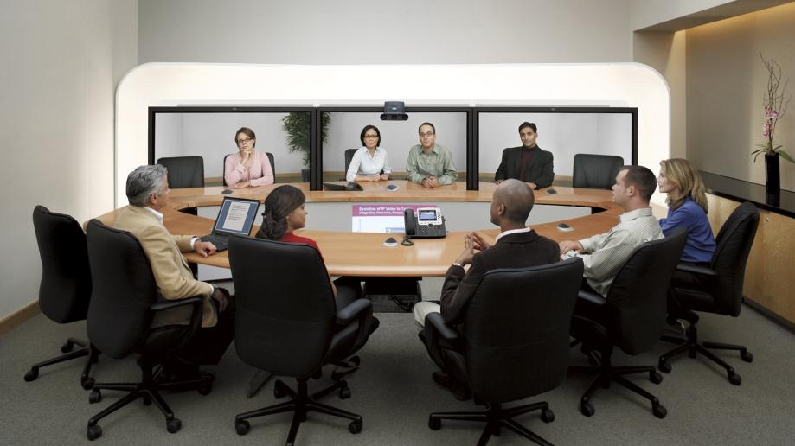
Networking Today The Global Community

Slide 7
Interconnecting our lives
Networking Impacts in Our Daily Lives
▪ Networks support the way we learn.
▪ Networks support the way we communicate.
▪ Networks support the way we work.
▪ Networks support the way we play.

Slide 8
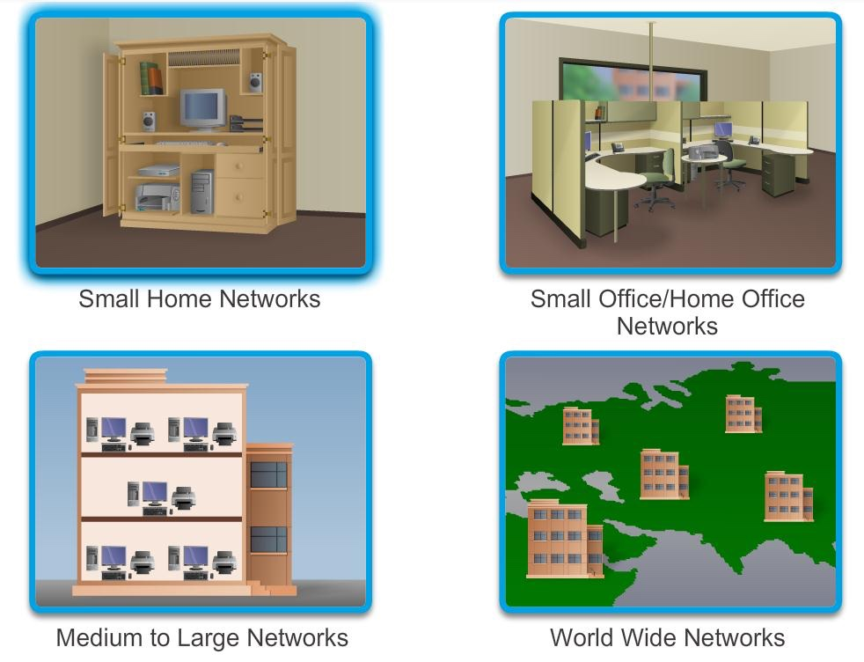
Networks of Many Sizes

Slide 9
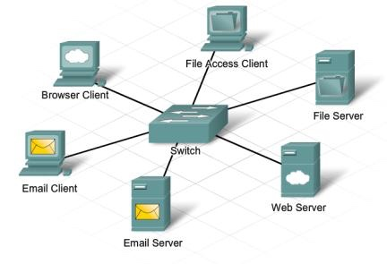
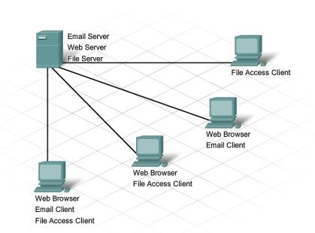
Clients and Servers

Slide 10
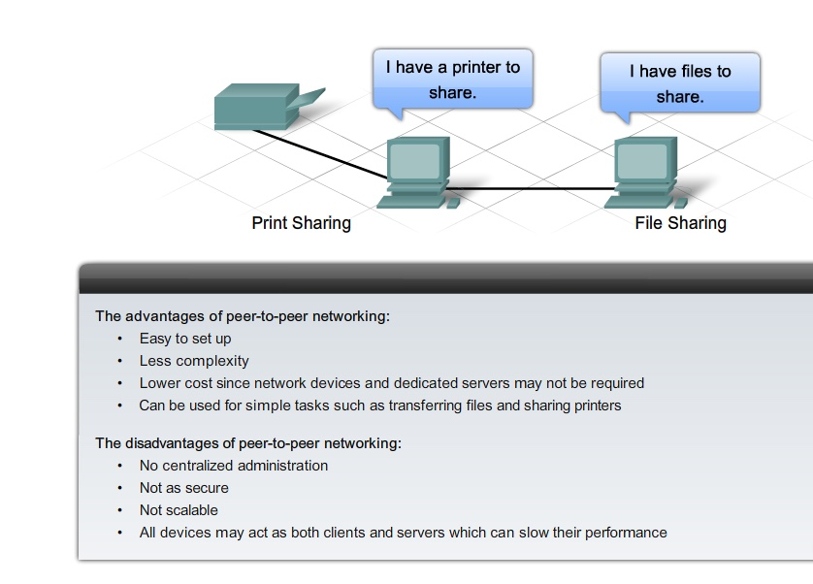
Providing Resources in a Network
Peer-to-Peer

Slide 11
LANs, WANs, and the Internet

Slide 12
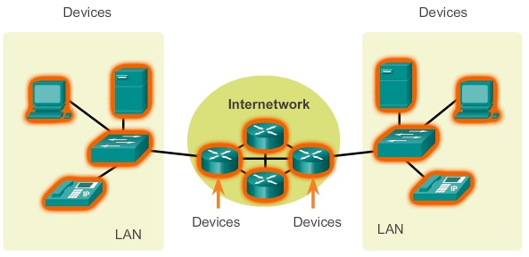
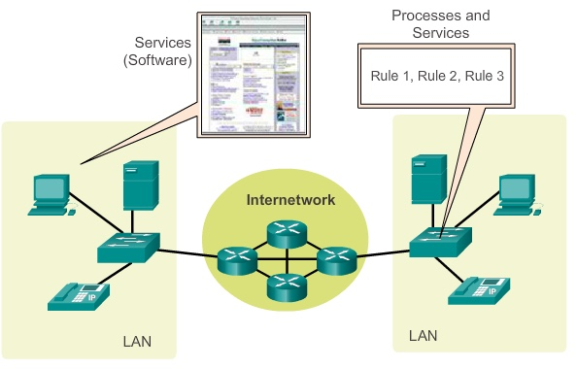
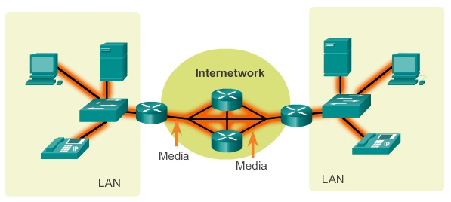
LANs, WANs, and Internets
Components of a Network
There are three categories of network components:
▪ Devices
▪ Media
▪ Services

Slide 13
Components of a Network
End Devices
Some examples of end devices are:
▪ Computers (work stations, laptops, file servers, web servers)
▪ Network printers
▪ VoIP phones
▪ TelePresence endpoint
▪ Security cameras
▪ Mobile handheld devices (such as smart phones, tablets, PDAs, and
wireless debit / credit card readers and barcode scanners)

Slide 14
Components of a Network
Network Infrastructure Devices
Examples of intermediary network devices are:
▪ Network Access Devices (switches, and wireless access points)
▪ Internetworking Devices (routers)
▪ Security Devices (firewalls)

Slide 15
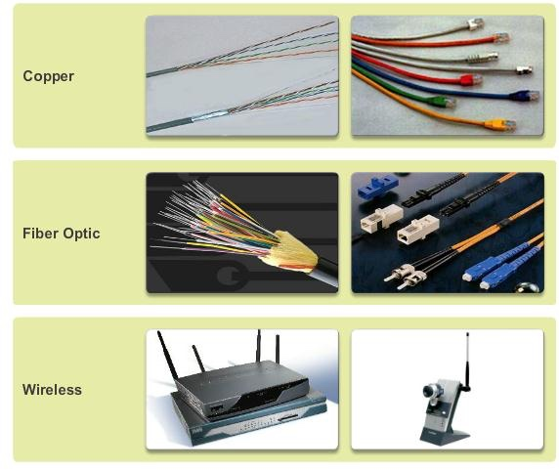
Components of a Network
Network Media

Slide 16
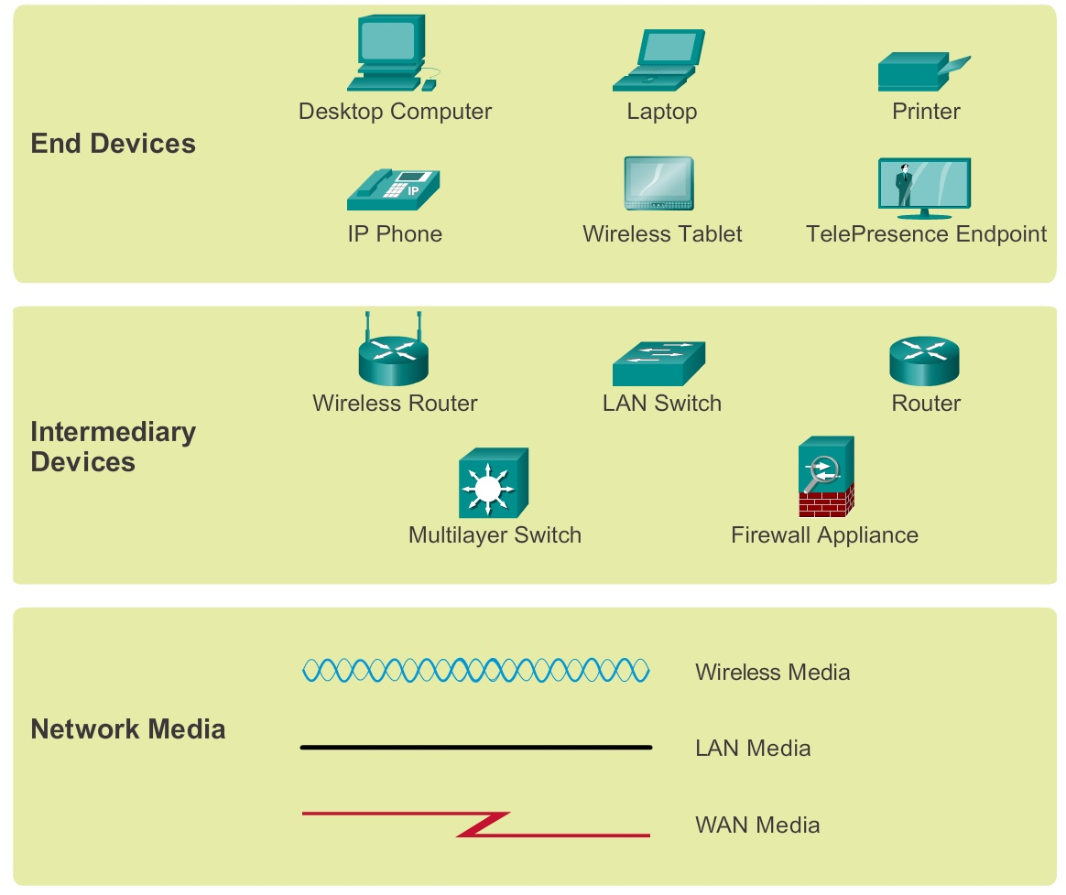
Components of a Network
Network Representations

Slide 17
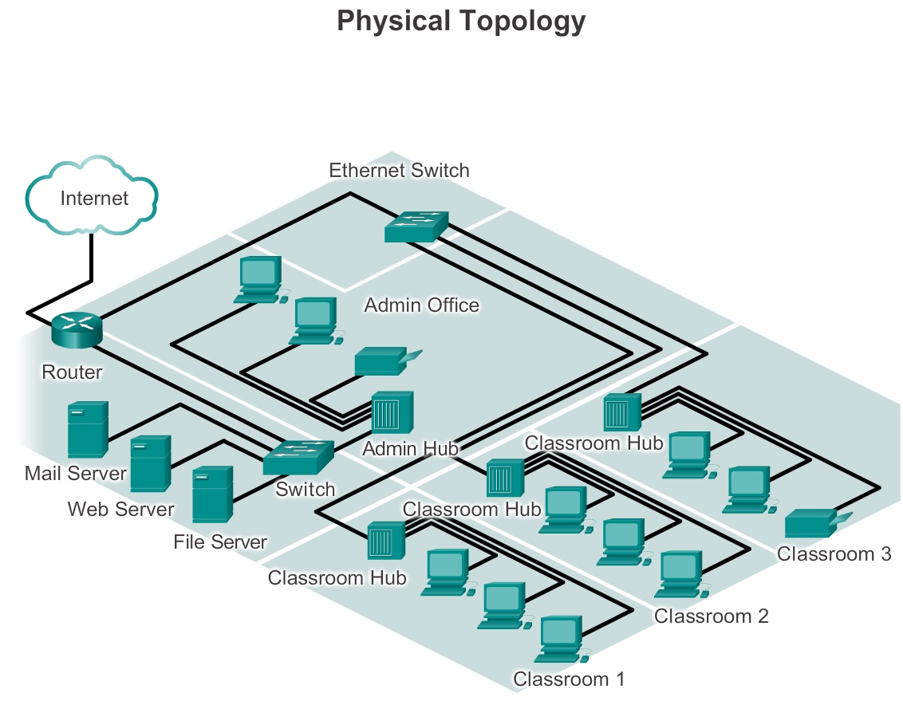
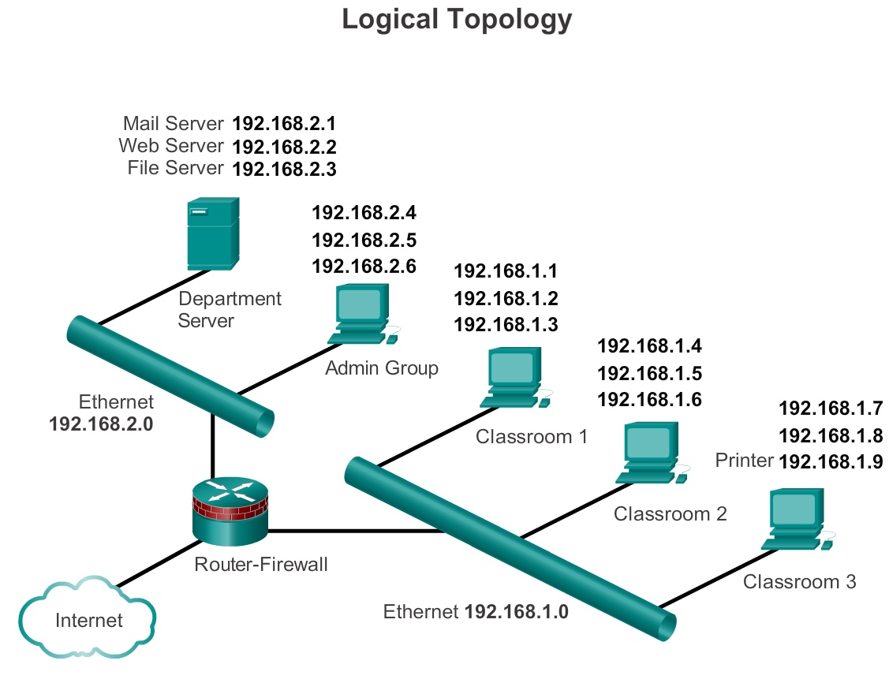
Components of a Network
Topology Diagrams

Slide 18
LANs and WANs
Types of Networks
The two most common types of network infrastructures are:
▪ Local Area Network (LAN)
▪ Wide Area Network (WAN).
Other types of networks include:
▪ Metropolitan Area Network (MAN)
▪ Wireless LAN (WLAN)
▪ Storage Area Network (SAN)

Slide 19
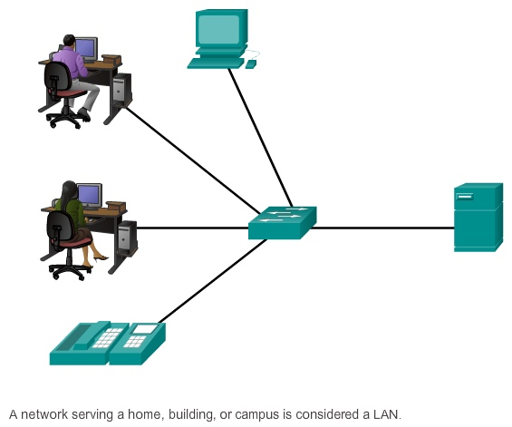
LANs and WANs
Local Area Networks (LAN)

Slide 20
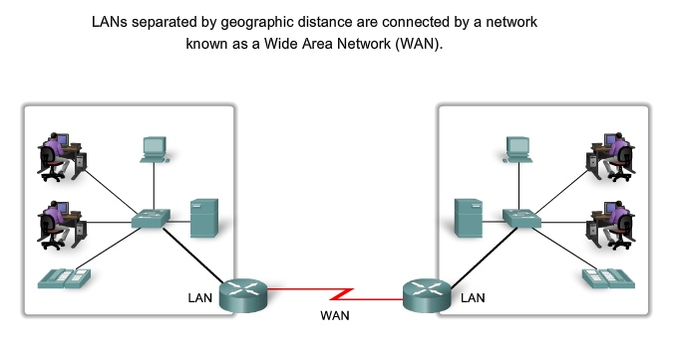
LANs and WANs
Wide Area Networks (WAN)

Slide 21
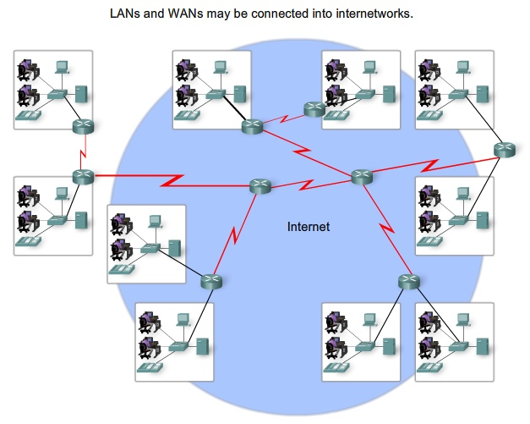
LANs, WANs, and the Internet
The Internet

Slide 22
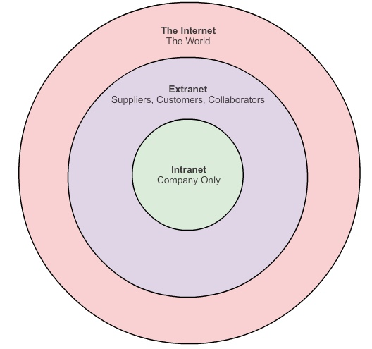
LANs, WANs, and the Internet
Intranet and Extranet

Slide 23
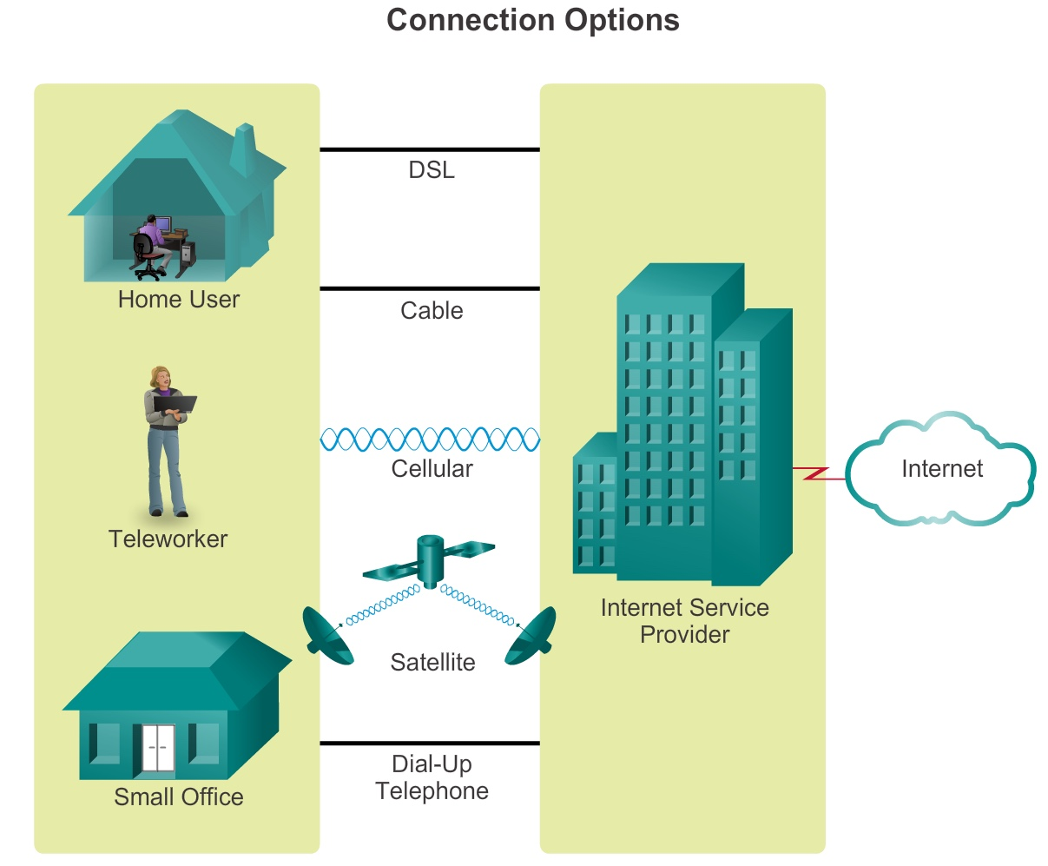
Connecting to the Internet
Connecting Remote Users to the Internet

Slide 24
The Network as a Platform

Slide 25
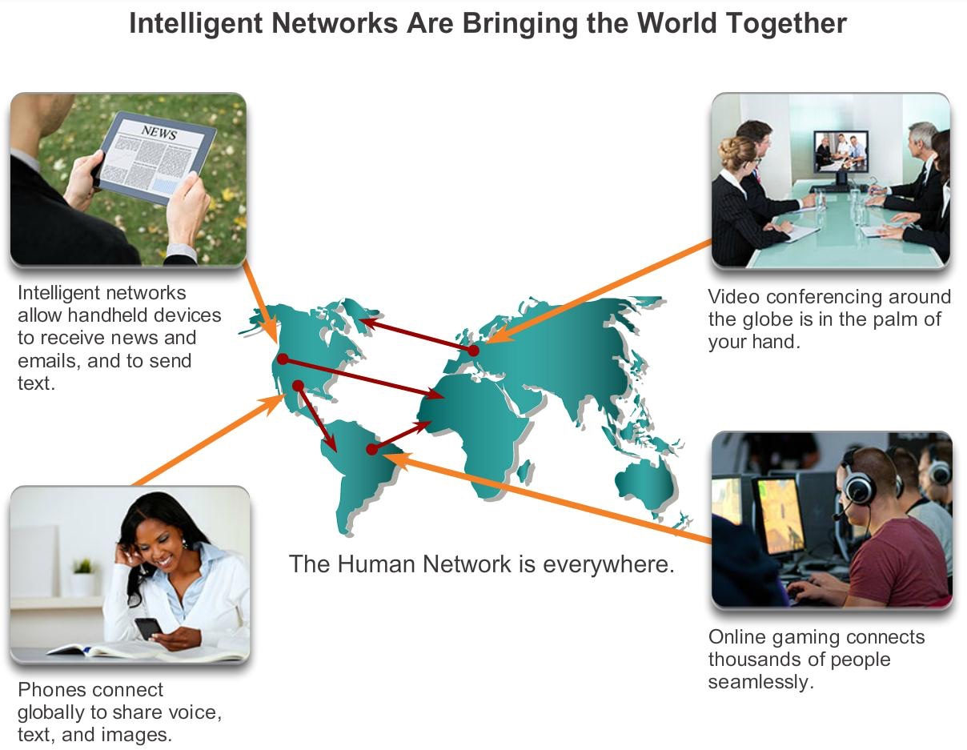
Converged Networks
Planning for the Future

Slide 26
Reliable Network
Supporting Network Architecture
As networks evolve, we are discovering that there are four basic
characteristics that the underlying architectures need to address in order to
meet user expectations:
▪ Fault Tolerance
▪ Scalability
▪ Quality of Service (QoS)
▪ Security

Slide 27
The Changing Network Environment

Slide 28
Network Trends
New trends
Some of the top trends include:
▪ Bring Your Own Device (BYOD)
▪ Online collaboration
▪ Video
▪ Cloud computing

Slide 29

Network Trends
Bring Your Own Device (BYOD)
The concept of any device, to any content, in anyway is a major global
trend that requires significant changes to the way devices are used.
This trend is known as Bring Your Own Device (BYOD).

Slide 30
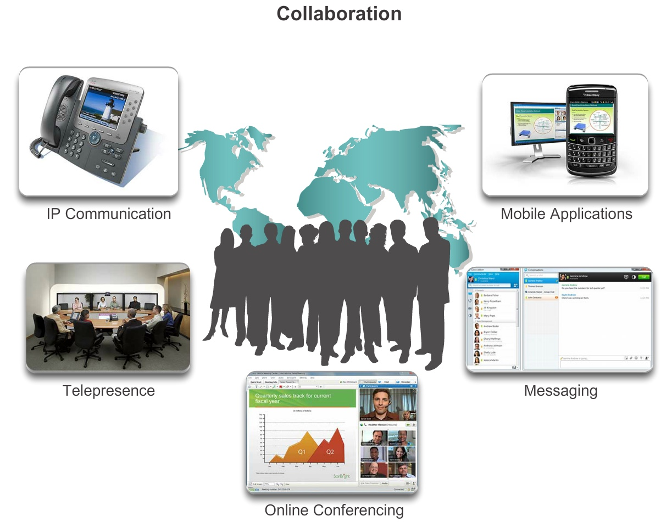
Network Trends
Online Collaboration

Slide 31
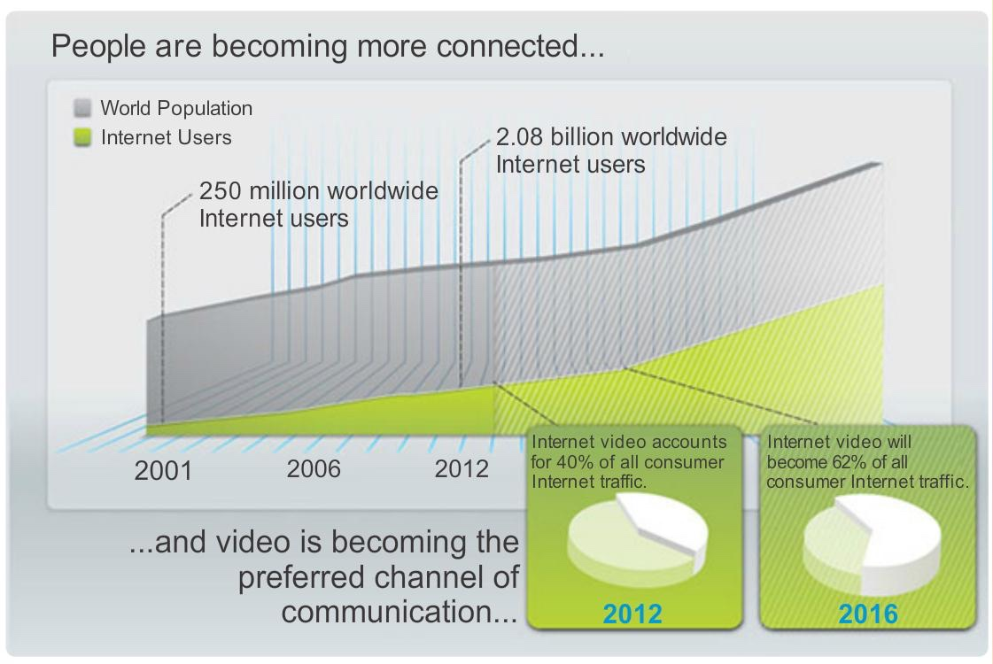
Network Trends
Video Communication

Slide 32
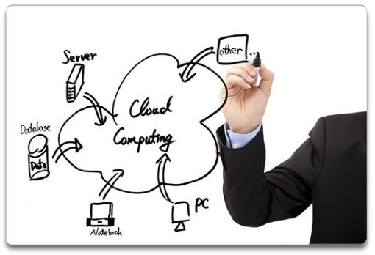
Network Trends
Cloud Computing
Cloud computing offers the following potential benefits:
▪ Organizational flexibility
▪ Agility and rapid deployment
▪ Reduced cost of infrastructure
▪ Refocus of IT resources
▪ Creation of new business
models

Slide 33
Network Trends
Data Centers
A data center is a facility used to house computer systems and associated
components including:
▪ Redundant data communications connections
▪ High-speed virtual servers (sometimes referred to as server farms or
server clusters)
▪ Redundant storage systems (typically uses SAN technology)
▪ Redundant or backup power supplies
▪ Environmental controls (e.g., air conditioning, fire suppression)
▪ Security devices

Slide 34
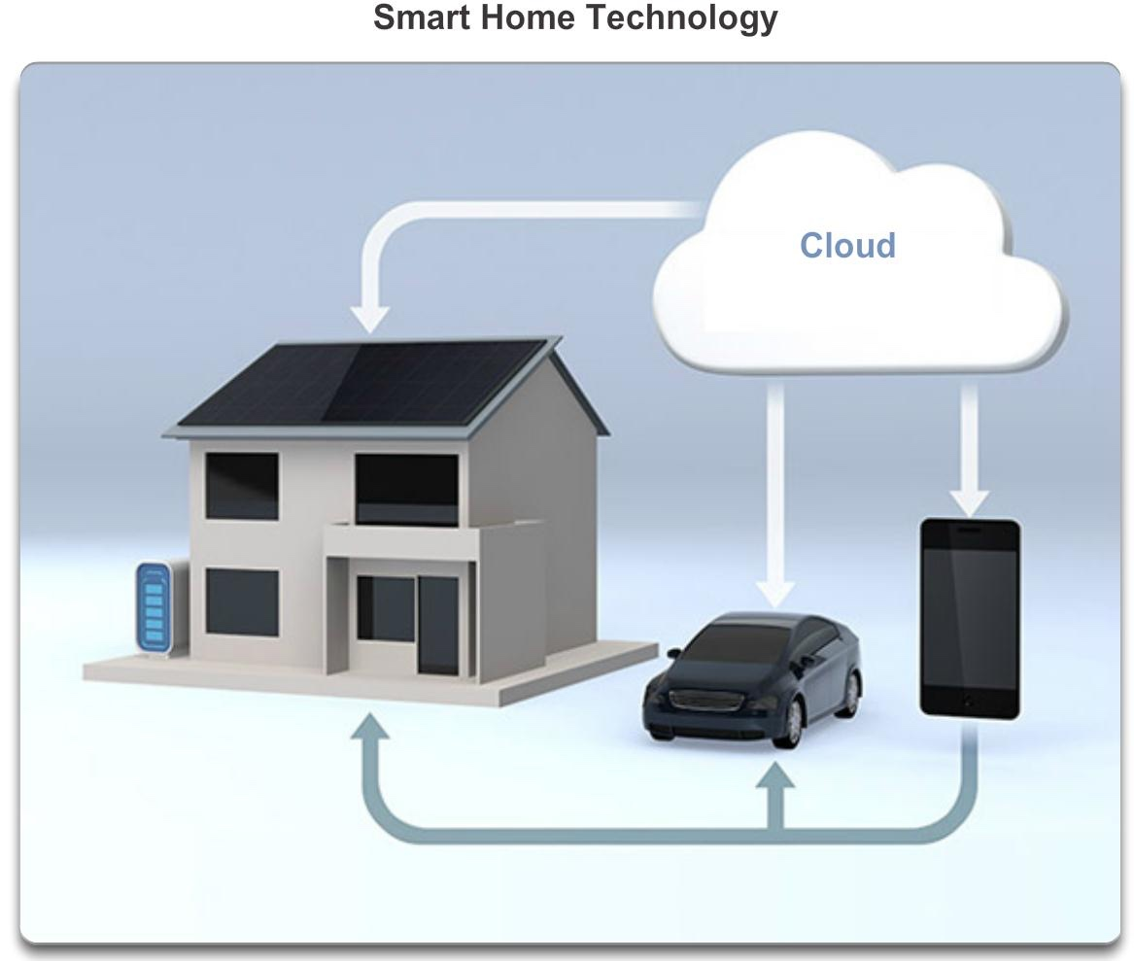
Networking Technologies for the Home
Technology Trends in the Home

Slide 35
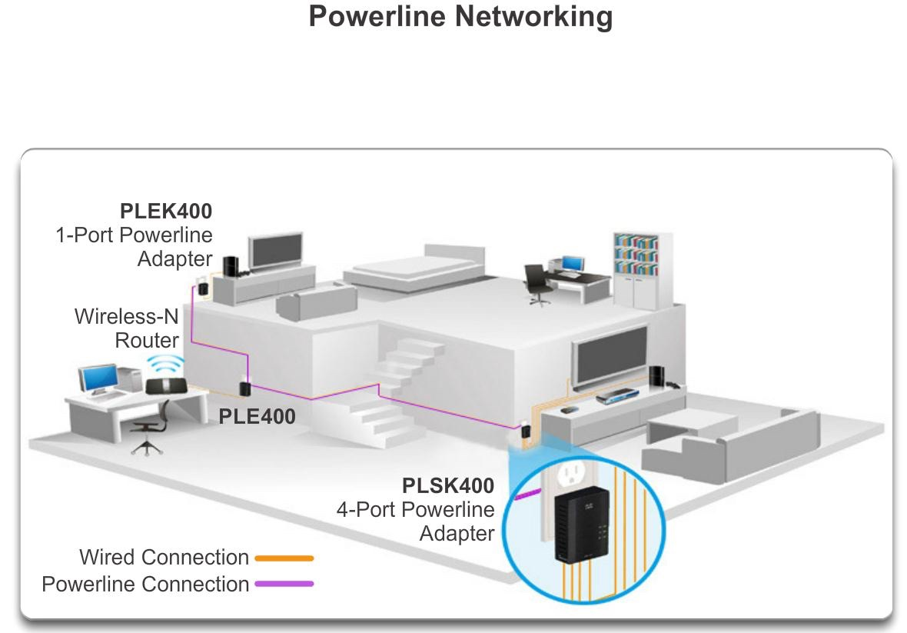
Networking Technologies for the Home
Powerline Networking

Slide 36
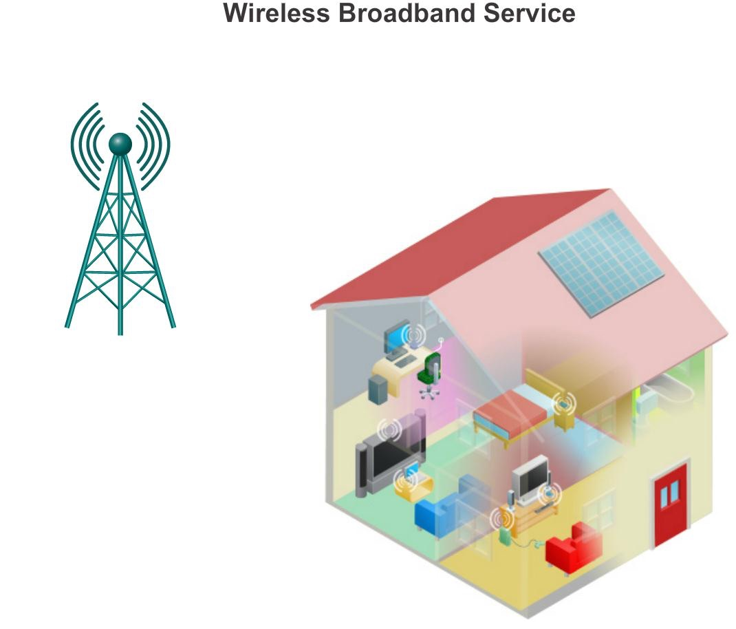
Networking Technologies for the Home
Wireless Broadband

Slide 37
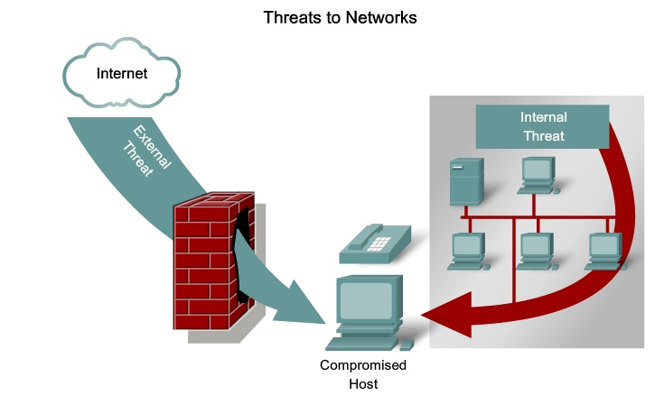
Future of Networking
Network Security

Slide 38
Network Security
Security Threats
The most common external threats to networks include:
▪ Viruses, worms, and Trojan horses
▪ Spyware and adware
▪ Zero-day attacks, also called zero-hour attacks
▪ Hacker attacks
▪ Denial of service (DoS) attacks
▪ Data interception and theft
▪ Identity theft

Slide 39
Significance of networking in communication technology
Data Communications
Transmission of signals
Encoding, interfacing, signal integrity, multiplexing etc.
Networking
Topology & architecture used to interconnect devices
Networks of communication systems

Slide 40
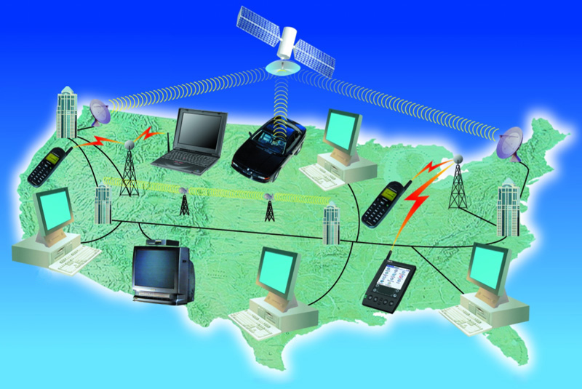
Communications Components
Basic components of a communication system
Communication technologies
Communication devices
Communication channels
Communication software

Slide 41
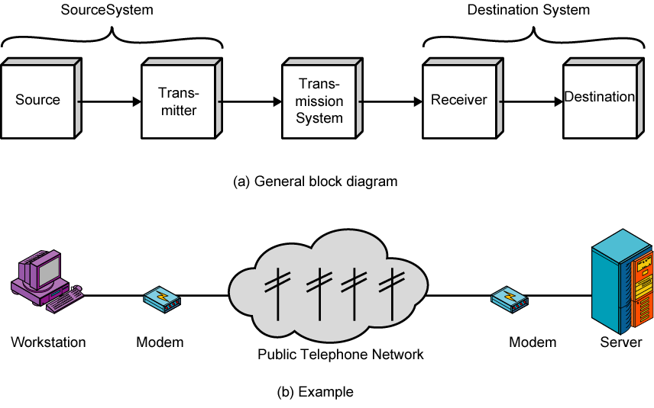
A Communications Model

Slide 42
Lesson Summary
The benefits and constraints of different network types and standards.
The purpose, resource implications, communications, working practice, commercial opportunity, information sharing and collaboration.

Slide 43
Role of networks: Purpose, benefits, resource implications, communications, working practice, commercial opportunity, information sharing, collaboration.

Slide 44
System types:
Peer-based, client-server, cloud, cluster, centralized, virtualized

Slide 45
Networking standards:
Conceptual models e.g. OSI model, TCP/IP model; standards: e.g. IEEE 802.x.

Slide 46
Topology:
Logical e.g. Ethernet, Token Ring; physical e.g. star, ring, bus, mesh, tree, ring.

Slide 47
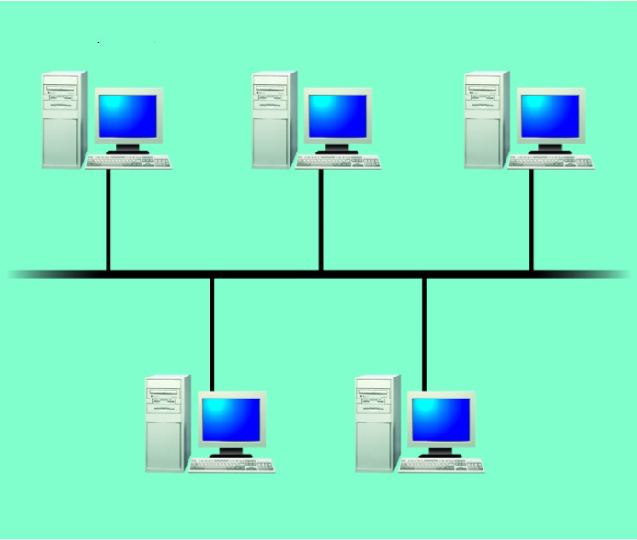
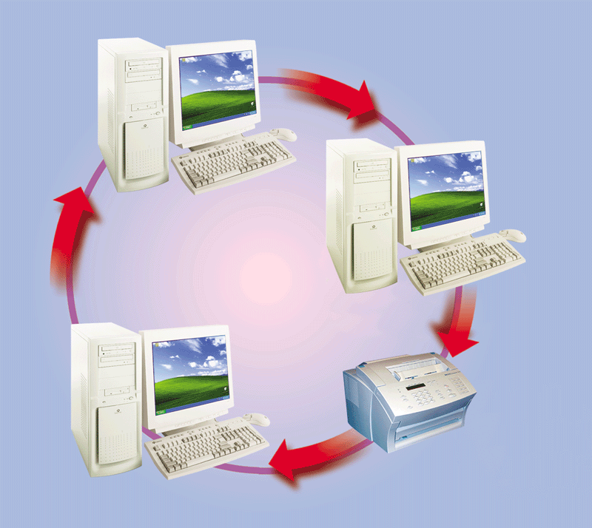
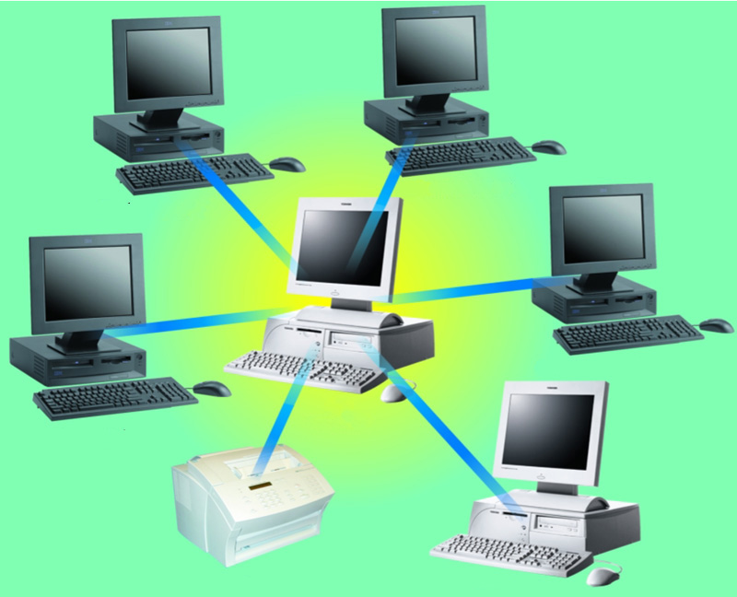
Network Topologies
personal computer
personal computer
personal computer
personal computer
personal computer
personal computer
personal computer
personal computer
personal computer
host computer
printer
file server

Slide 48
Components of a Network
Topology Diagrams

Slide 49
Protocols:
Purpose of protocols; routed protocols e.g. IPv4, IPv6, IPv6 addressing, Global unicast, Multicast, Link local, Unique local, EUI 64, Auto configuration, FTP, HTTP, SMTP, POP3, SSL; management of protocols for addressing.

Slide 50
Protocols
Rules of Communication
Network Protocols and Standards
Moving Data in the Network

Slide 51
Network Protocols and
Communications

Slide 52

Rules of
Communication

Slide 53
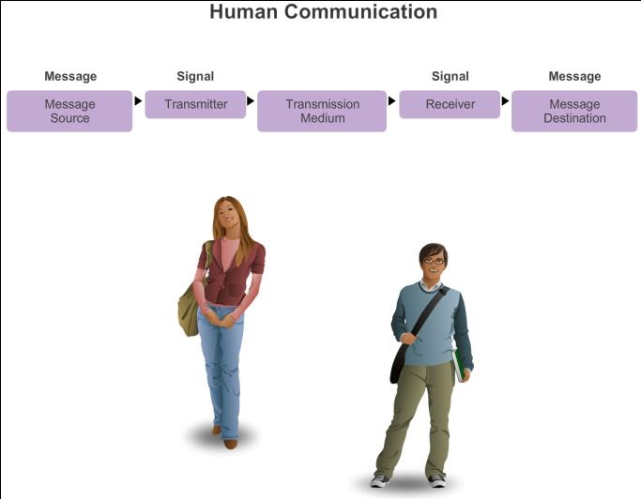
The Rules
What is Communication?

Slide 54
The Rules
Establishing the Rules
▪ An identified sender and receiver
▪ Agreed upon method of communicating (face-to-face, telephone, letter,
photograph)
▪ Common language and grammar
▪ Speed and timing of delivery
▪ Confirmation or acknowledgment requirements
Establishing the Rules

Slide 55
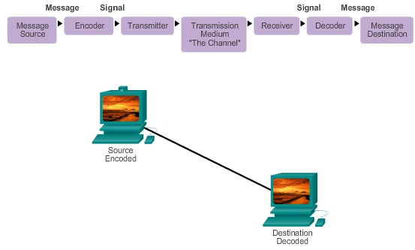
The Rules
Message Encoding

Slide 56
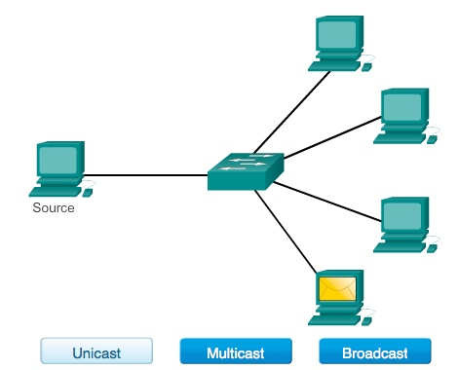
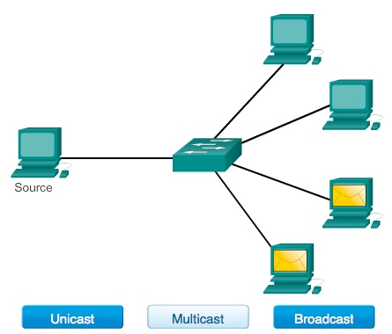
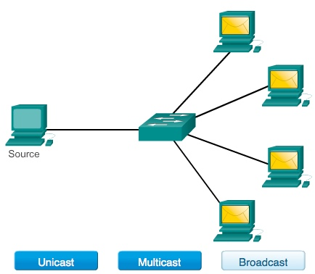
The Rules
Message Delivery Options

Slide 57
Network Protocols and Standards
Principles and their protocols

Slide 58
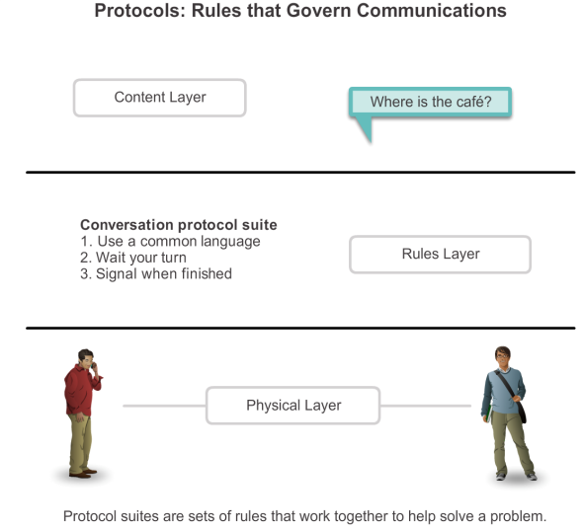
Protocols
Rules that Govern Communications

Slide 59
Protocols
Network Protocols
▪ How the message is formatted or structured
▪ The process by which networking devices share information about
pathways with other networks
▪ How and when error and system messages are passed between devices
▪ The setup and termination of data transfer sessions

Slide 60
Protocols
Interaction of Protocols
▪ Application Protocol – Hypertext Transfer Protocol (HTTP)
▪ Transport Protocol – Transmission Control Protocol (TCP)
▪ Internet Protocol – Internet Protocol (IP)
▪ Network Access Protocols – Data link & physical layers

Slide 61
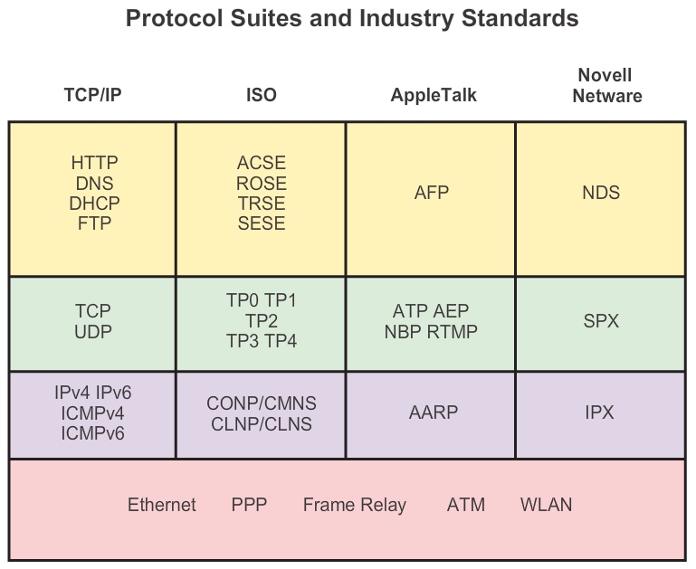
Protocol Suites
Protocol Suites and Industry Standards

Slide 62
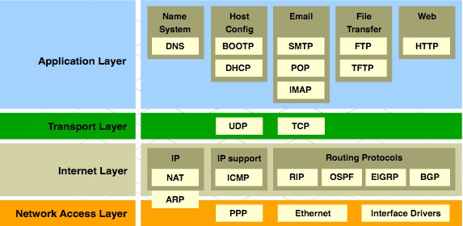
Protocol Suites
TCP/IP Protocol Suite and Communication

Slide 63







Standards Organizations
Open Standards
▪ The Internet Society (ISOC)
▪ The Internet Architecture Board (IAB)
▪ The Internet Engineering Task Force (IETF)
▪ Institute of Electrical and Electronics Engineers (IEEE)
▪ The International Organization for Standards (ISO)

Slide 64

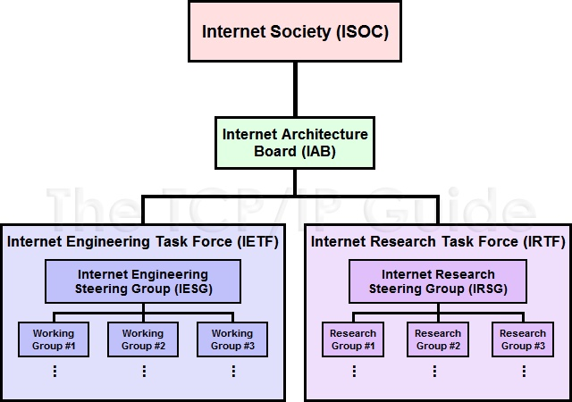



Standards Organizations
ISOC, IAB, and IETF

Slide 65
Summary
The benefits and constraints of different network types and standards.
Investigate the purpose, resource implications, communications, working practice, commercial opportunity, information sharing and collaboration.

Slide 66
Summary
Peer-based, client-server, cloud, cluster, centralised, virtualised

Slide 67
LAB
Download Packet Tracer

